Slide 1
2-D Arrays

Slide 2
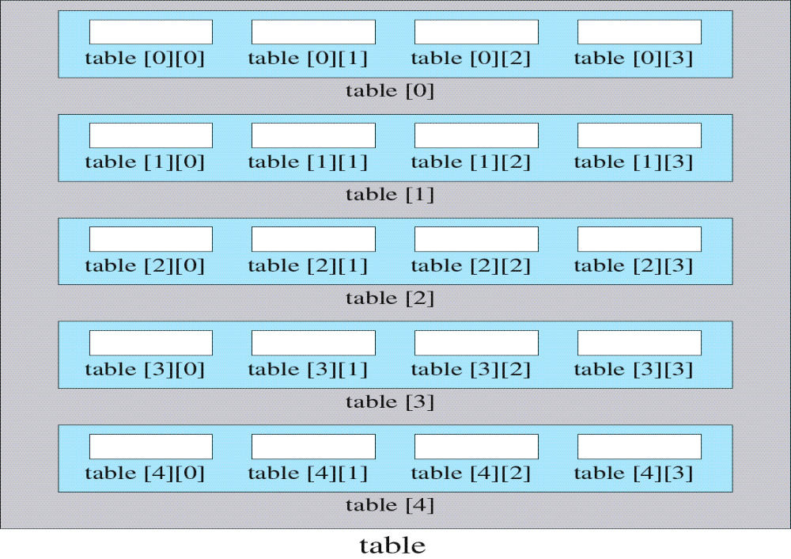
2-D Array Example

Slide 3
2-D Array Example
  // 2-D array of 30 uninitialized ints
  int table[3][10];
0
1
2
3
4
5
6
7
8
9
0
--
--
--
--
--
--
--
--
--
--
1
--
--
--
--
--
--
--
--
--
--
2
--
--
--
--
--
--
--
--
--
--

Slide 4
2-D Array References
  // 2-D array of 18 uninitialized chars
  char table[3][6];
  table[1][2] = 'a';
  char resp = table[1][2];
0
1
2
3
4
5
table
0
--
--
--
--
--
--
1
--
--
a
--
--
--
2
--
--
--
--
--
--

Slide 5
2-D Array Initialization
  Declaration only reserves memory for the elements in the array. No values will be stored. If we don't initialize the array, the contents are unpredictable. Generally speaking, all arrays should be initialized.
  One way to initialize a 2D array is shown below
  // 2-D array of 18 initialized chars
  const int NUM_ROWS = 3, NUM_COLS = 6;
  char table[NUM_ROWS][NUM_COLS]={'a','b','c','d',
  'e','f','g','h','i','j','k','l','m','n',
  'o','p','q','r'};
0
1
2
3
4
5
table
0
a
b
c
d
e
f
1
g
h
i
j
k
l
2
m
n
o
p
q
r

Slide 6
Ex. 1: 2-D Array Initialization
  It is highly recommended, however, that you nest the data in braces to show the exact nature of the array. For example, array table is better initialized as :
  // 2-D array of 18 initialized chars
  const int NUM_ROWS = 3, NUM_COLS = 6;
  char table[NUM_ROWS][NUM_COLS]={
  {'a','b','c','d','e','f'},
  {'g','h','i','j','k','l'},
  {'m','n','o','p','q','r'}
  };
0
1
2
3
4
5
table
0
a
b
c
d
e
f
1
g
h
i
j
k
l
2
m
n
o
p
q
r

Slide 7
Ex. 1: 2-D Array Inputting Values
  Another way to fill up the values is to read them from the keyboard. For a two-dimensional array this usually requires nested for loops. If the array is an n by m array, the first loop varies the row from 0 to n-1. The second loop varies the column from 0 to m -1.
  const int NUM_ROWS = 3, NUM_COLS = 6;
  for (int row=0; row < NUM_ROWS; row++)
  for (int column = 0; column < NUM_COLS; column++)
  cin>>table[row][column];
  //input “two-dimensional array”
0
1
2
3
4
5
table
0
t
w
o
-
d
i
1
m
e
n
s
i
o
2
n
a
l
a
r

Slide 8
Ex. 1: 2-D Array Outputting Values
  We can print the values of the elements one-by-one using two nested loops. Again, if the array is an n by m array, the first loop varies the row from 0 to n-1. The second loop varies the column from 0 to m-1.
  const int NUM_ROWS = 3, NUM_COLS = 6;
  for (int row=0; row < NUM_ROWS; row++)
  for (int column = 0; column < NUM_COLS; column++)
  cout << table[row][column];
0
1
2
3
4
5
table
0
t
w
o
-
d
i
1
m
e
n
s
i
o
2
n
a
l
a
r

Slide 9
Ex. 2: Addition Table
  We can store the values of the elements in an addition table in a two-dimensional array using two nested loops. Again, if the array is an n by n array, the first loop varies the row from 0 to n-1. The second loop varies the column from 0 to n-1.
0
1
2
3
table
0
0
1
2
3
1
1
2
3
4
2
2
3
4
5
3
3
4
5
6

Slide 10
Ex. 2: Addition Table
// An addition table in a 2-dimensional array
#include <iostream.h>
const int TABLE_SIZE = 4; // global size of addition table
int main(){
int row, column;
int add_table [TABLE_SIZE][TABLE_SIZE];// declare array
// create the array for the addition table
for (row = 0; row < TABLE_SIZE; row++){
for (column = 0; column < TABLE_SIZE; column++){
add_table[row][column] = row + column;
}}

Slide 11
Ex. 2: Addition Table
// Print the addition table
for (row = 0; row < TABLE_SIZE; row++){
for (column = 0; column < TABLE_SIZE; column++){
cout << add_table[row][column] << " ";
}
cout << endl;
}
return 0;
}

Slide 12
Mathematical Functions
#include <cmath.h>
double log(double x) //natural logarithm
double log10(double x) //base 10 logarithm
double exp(double x) //e to the power x
double pow(double x, double y) //x to the power y
double sqrt(double x) //positive square root of x
double sin(double x), cos(double x), tan(double x)
//and many others

Slide 13
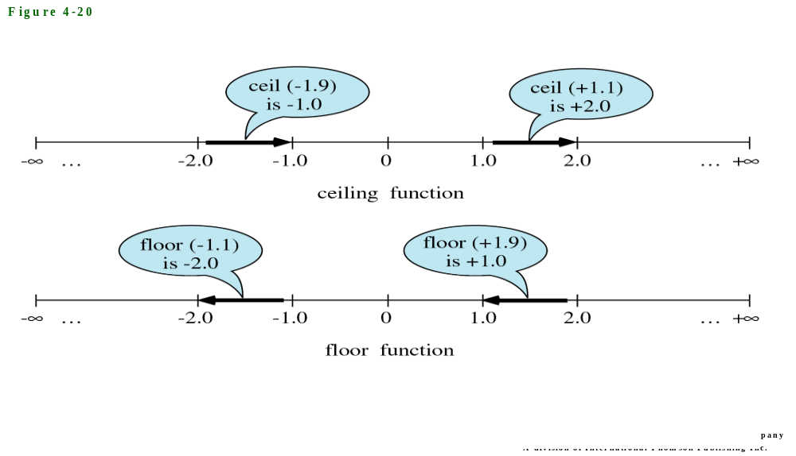
Mathematical Functions
double ceil(double x) //smallest integer not less than x
// ceil(1.1) == 2, ceil(-1.9) == -1
double floor(double x) //largest integer not greater than x
// floor(1.9) == 1, floor(-1.1) == -2

Slide 14
Ex. 3: Distance Between Two Points
#include <cmath.h> // contains sqrt()
#include <iostream.h>
int main(){
double col1, row1, col2, row2; // coordinates for pnt 1 & 2
double dist; // distance between points
cout << "Enter col(x) & row(y) coordinates of 1st point: ";
cin >> col1 >> row1;
cout << "Enter col(x) & row(y) coordinates of 2nd point: ";
cin >> col2 >> row2;
// Compute the distance between points 1 & 2
//dist=sqrt((col2-col1)*(col2-col1)+(row2-row1)*(row2-row1));
dist = sqrt(pow((col2 – col1),2) + pow((row2-row1),2));
cout << "The distance is " << dist << endl;
return 0; }

Slide 15
Ex. 4 & 5: Graphing Trajectories
The next 2 examples use arrays to store the characters in a grid.
  Example 4 graphs one line on the grid.
  Example 5 graphs multiple lines on the grid, using an extra while loop.

Slide 16
Ex. 4: Trajectory Between 2 Points
x
0 | 1 | 2 | 3 | 4 | 5 | 6 | 7 | 8 | 0 | 10 | 11 | 12 | 13 | 14 | 15
1 |  | *
2 |  |  | *
3 |  |  |  | *
4 |  |  |  |  | *
5 |  |  |  |  |  | *
y

Slide 17
Ex. 4: Graphing a Trajectory
Given a pair of coordinates (x1, y1), (x2, y2), we can easily get its formula:
(y – y1)/(x – x1) = (y2 – y1)/(x2 – x1) = k
which can also be written as:
y = k * (x – x1) + y1
Assuming x1 < x2, using a for loop, we can set x be x1+1, x1+2, x1+3 … until x2-1, and calculate the correspond y and plot them on the grid.

Slide 18
Ex. 4: Graphing a Trajectory
// Graph line between two points
#include <iostream.h>
int const NUMBER_ROWS = 11; // global constants
int const NUMBER_COLS = 31;
int main(){
// set an array for the grid
char grid[NUMBER_ROWS][NUMBER_COLS];
int row, col, row1, col1, row2, col2; // coordinates
double rise, run, slope;
// for background, fill grid with '-' character
for (row = 0; row < NUMBER_ROWS; row++)
for(col = 0; col < NUMBER_COLS; col++)
grid[row][col] = '-';

Slide 19
Ex. 4: Graphing a Trajectory
// get user input and check that it is on the grid
do{
cout << "Enter column (x<" << NUMBER_COLS
<< ") & row (y<"
<< NUMBER_ROWS <<") coordinates of the 1st point: ";
cin >> col1 >> row1;
} while((row1 < 0) || (row1 >= NUMBER_ROWS) || (col1<0) ||
(col1 >= NUMBER_COLS));
do{
cout << "Enter column (x<" << NUMBER_COLS
<< ") & row (y<"
<< NUMBER_ROWS <<") coordinates of the 2nd point: ";
cin >> col2 >> row2;
} while((row2<0) || (row2 >= NUMBER_ROWS) || (col2<0) ||
(col2 >= NUMBER_COLS));

Slide 20
Ex. 4: Graphing a Trajectory
// put characters into array to graph the line on grid
// handle special cases where col1 == col2 first
// to avoid division by 0
if((row1 == row2) && (col1 == col2)) // just one point
grid[row1][col1] = '*';
else if(col2 == col1){ //slope is infinite
if (row1 < row2) //fill downward
for(row = row1; row <= row2; row++)
grid[row][col1] = '*';
else //fill upward
for(row = row1; row >= row2; row--)
grid[row][col1] = '*';
}

Slide 21
Ex. 4: Graphing a Trajectory
else{
rise = row2 - row1;
run = col2 - col1;
slope = rise / run; // run cannot = 0
if (run >0){
for(col = col1; col <= col2; col++){
// row1 is offset for starting point
row = (int)(slope * (col - col1) + row1);
grid[row][col] = '*';
}
}
else{
for(col = col1; col >= col2; col--){
row = (int)(slope * (col - col1) + row1);
grid[row][col] = '*';
}
}
}

Slide 22
Ex. 4: Graphing a Trajectory
// print the grid from the array to the screen
for(row = 0; row < NUMBER_ROWS; row++){
for(col = 0; col < NUMBER_COLS; col++){
cout << grid[row][col];
}
cout << endl;
}
return 0;
}

Slide 23
Ex. 5: Trajectories Among Points
x
0 | 1 | 2 | 3 | 4 | 5 | 6 | 7 | 8 | 0 | 10 | 11 | 12 | 13 | 14 | 15
1 |  | * |  |  |  |  |  |  |  | * | * | * | *
2 |  |  | * |  | * | * | * | * | *
3 |  |  | * | *
4 |  |  |  |  | *
5 |  |  |  |  |  | *
y

Slide 24
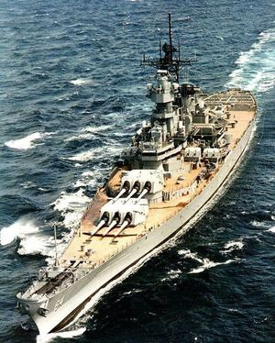
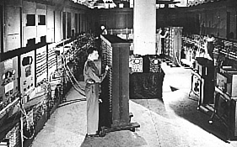
The First Computer
The construction of the first electronic computer, named the ENIAC, was commissioned by the US military in 1943 to compute the trajectory of a 16-in naval shell. But WWII was already over when the ENIAC was completed. All together, the U.S. Army provided approximately $500,000 for the ENIAC's development.

Slide 25

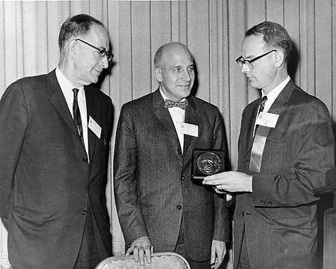
The First Computer
ENIAC (Electronic Numerical Integrator and Computer)
Development period: 1943-1946
Designers: John Mauchly and J. Presper Eckert, Jr.

Slide 26
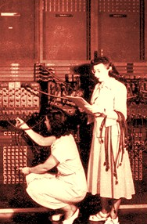
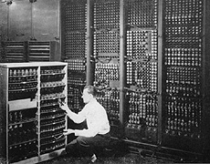
The First Computer
Development organization: The Moore School of Electrical Engineering, University of Pennsylvania
Components: 18,000 vacuum tubes
Weight: 30 tons
Room to hold it: 1,500 square feet
Word size: 10 decimal digits
Cycle time: 100K Hz
Internal storage: none

Slide 27
Flight Distance of a Projectile
Newton's laws of motion
  V = V0 + a t (1)
  S = V0 t + ½ a t² (2)
Where
  V is the velocity after acceleration;
  V0 is the initial velocity;
  a is the acceleration;
  t is the flight time;
  S is the flight distance.

Slide 28
Flight Distance of a Projectile
Assuming no air resistance
  Vy = 0 when it is half way into the flight
  ay = -g gravity which is 9.8 meters/sec²
  half flight time t = V0y/g = V0 * sin(¼ π)/9.8 (1)
  flight_distance = V0x * 2 * t = V0 * cos(¼ π) * 2 * t (2)
For example, for a howitzer (Type-1954 122 mm, made in China) with muzzle speed of 515 meters/sec pointing at 45º upward.
  flight_time = 2 * 515 * sin(¼ π )/9.8
  flight_distance = 515 * cos(¼ π) * flight_time

Slide 29
Flight Distance of a Projectile
V₀ cos(θ)
V₀
θ
V₀ sin(θ)

Slide 30

A Plotting Function
//Function that places a 'o' at location (x,y)
void graph_x_y(int x, int y){
if (x >= 0 && x < x_size &&
y >= 0 && y < y_size)
grid[x][y] = 'o';
}

Slide 31
Using the Plotting Function
/*Draw a trajectory for a gun whose muzzle speed is 515 meters/sec at 45 degrees upward angle */
v = 515.0;
theta_r =0.25 * PI;
// Find 1/2 flight time using 0 = vy - gt
t_half = v * sin(theta_r) / GRAV;
fl_time = 2 * t_half;
// Find proper x-scale
x_scale = fl_time / x_size;
// Find max flight height
height=v*sin(theta_r)*t_half - 0.5*GRAV*t_half*t_half;
// Find proper y-scale
y_scale = (y_size - 1) / height;

Slide 32
Using the Plotting Function
// Graph this trajectory
for (i = 0; i < x_size; i++){
fl_time = i * x_scale;
h=int((v*sin(theta_r)*fl_time-
0.5*GRAV*fl_time*fl_time)*y_scale+0.5));
graph_x_y(i, h);
}
// Print the trajectories
for (int j = y_size-1; j >= 0; j--){
for (i = 0; i < x_size; i++)
cout << grid[i][j];
cout << endl;
}

Slide 33
Using the Plotting Function
Draw the trajectories of a gun whose muzzle speed is 515 meters/second
pointing at upward angles of 45 and 30 degrees:
ooooooooooo
oooo oooo
ooo ooo
ooo ooo
oo oo
o o
oo oo
o o
oo oo
o o
oo oooooooooooooooo oo
o ooo oooo o
o ooo oo o
o oo oo o
o oo oo o
o o oo o
ooo o o
oo oo o
oo o o
o ooo

